Slide 1
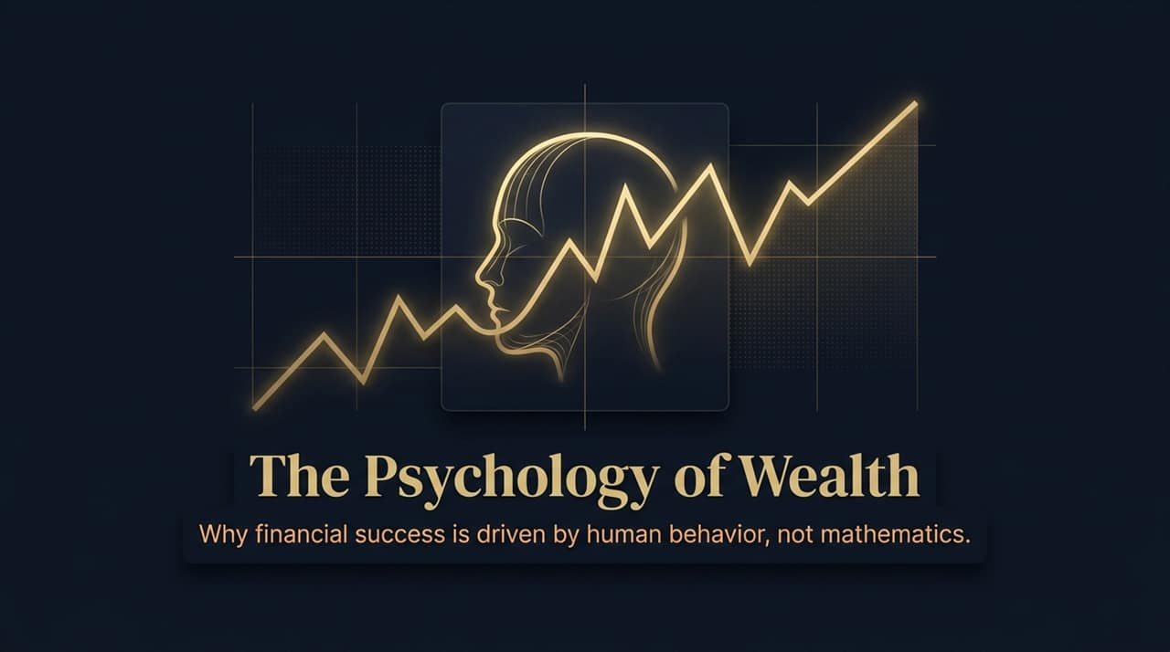
Notes:
Good morning/afternoon, everyone. Welcome to today’s session on 'Wealth Beyond Numbers: The Psychology of Wealth.'
Look at the visual on this opening slide: a human head intersecting with a volatile market chart. This isn't just an artistic graphic; it represents the core dilemma of modern finance. Most of us were raised to believe that managing money is a science—a linear equation solved by spreadsheets, formulas, and optimization models. But in reality, financial success is rarely about what you know about math; it is almost entirely about how you behave when emotions run high.
Over the next few minutes, we are going to unpack why financial mastery isn't an engineering problem, but a behavioral one. We’ll explore why the ultimate goal of money isn't to accumulate endless digits on a balance sheet, but to buy back your personal autonomy—your independence and your time. Let's begin by looking at how the financial landscape has fundamentally shifted over the last century.
https://www.youtube.com/watch?v=U49WKzpaD38

Slide 2
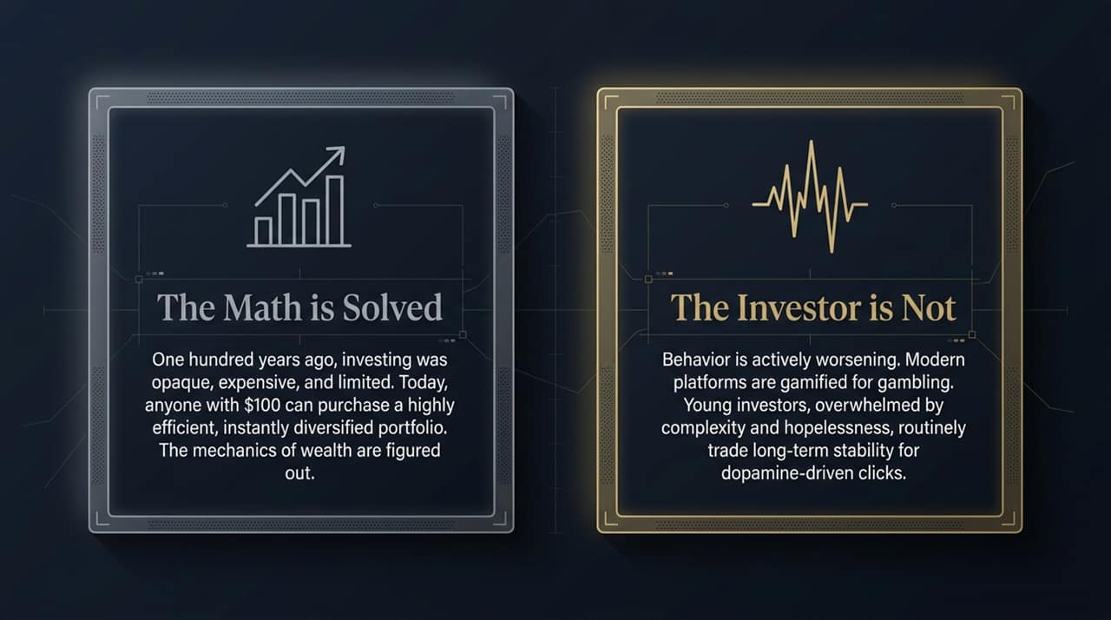
Notes:
Let's look at Slide 2. If you go back 50 to 100 years ago, investing was genuinely hard. If you were a dentist in 1925 and wanted to buy stocks, you had to deal with opaque information, outrageous broker commissions, and zero transparency. You were at the mercy of brokers who might put you in junk assets just to collect kickbacks.
Today, as Morgan Housel points out in his discussion, 'The math is solved.' Anyone with $100 and a smartphone can instantly purchase a low-cost, broadly diversified index fund. The tools, products, and mechanics required to build lifelong security are universally accessible.
But here is the paradox: We solved investing, but we have not solved the investor.
Modern financial platforms are gamified. They aren't designed to encourage long-term wealth building; they are optimized for dopamine hits, active trading, and speculation. When you combine high-frequency trading apps with a sense of modern hopelessness—where many young investors feel traditional pathways like buying a home are out of reach—they stop thinking long-term. They trade stability for high-risk gambles. Our tools have reached perfection, but our human behavior remains deeply flawed.

Slide 3
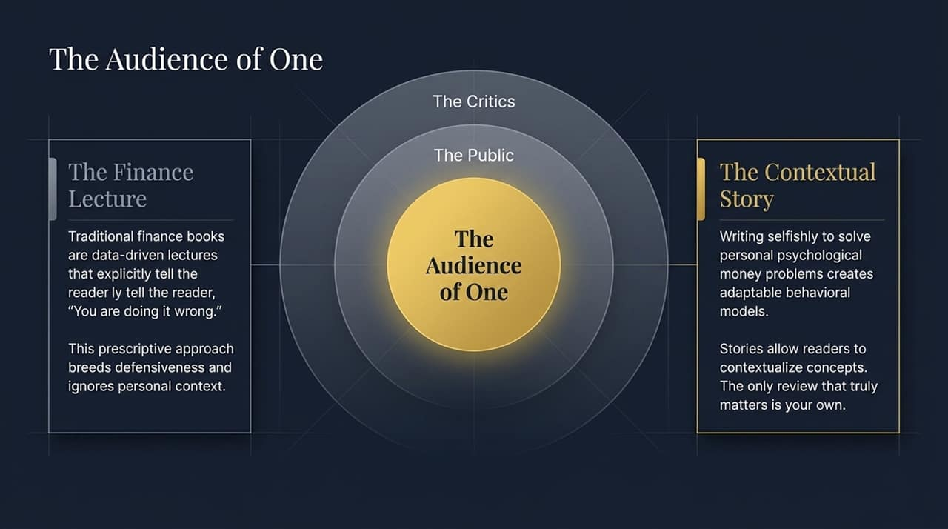
Notes:
Why do most traditional financial advice books fail to change people's behavior? Slide 3 illustrates this brilliantly.
Traditional financial literature operates like a stern academic lecture. It is packed with complex charts, formulas, and an underlying tone that explicitly tells the audience: 'You're doing it wrong, and you're making foolish choices.' When people feel judged or lectured, they naturally become defensive. They put up walls because a math formula cannot account for their individual risks, family history, or emotional reality.
In contrast, the most effective approach is writing or speaking for an 'Audience of One.' When Housel wrote The Psychology of Money, every major publisher initially rejected it because it lacked prescriptive 'do this, don't do that' advice. But instead of giving a lecture, he shared stories.
Stories allow you to see how other human beings process risk, greed, and fear, letting you contextualize those lessons into your own life. The key takeaway here is that you shouldn't manage your money based on what a textbook dictates or what society expects. The only financial review that truly matters is your own—solving your own psychological relationship with money.

Slide 4
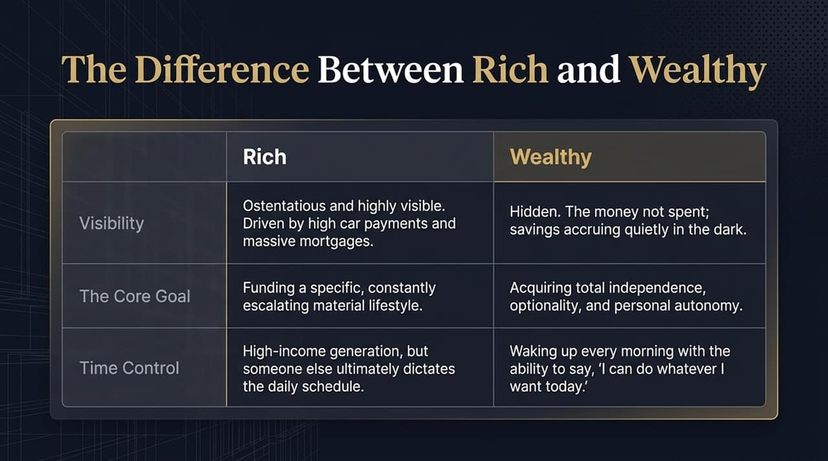
Notes:
One of the most important concepts we must clarify is the distinct line between being Rich and being Wealthy. Slide 4 breaks down these opposing realities.
Rich is about current income and high visibility. It’s ostentatious. It’s the fancy car, the massive home mortgage, the expensive designer watch. Being rich simply means you have enough current cash flow to fund an escalating material lifestyle. But here’s the catch: many 'rich' people have zero personal autonomy. Their entire schedule is dictated by a demanding job or debt obligations required to keep that lifestyle afloat.
Wealth, on the other hand, is hidden. Wealth is the money you haven't spent. It's the assets accumulating quietly in the bank, the unexercised options, the liquidity sitting in index funds.
The core goal of wealth isn't to show off; it is to purchase complete personal independence. As Housel defines it, true wealth is waking up every single morning and saying, 'I can do whatever I want today, with whomever I want, for as long as I want.' Wealth gives you freedom; richness often builds a gilded cage.

Slide 5
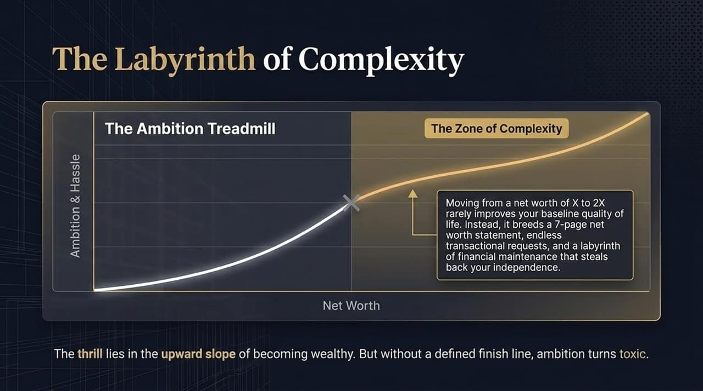
Notes:
As your financial status grows, there is a hidden trap waiting for you: The Labyrinth of Complexity.
Look at the curve on this graph. In the beginning, going from $0 to your first major savings target dramatically improves your baseline quality of life. It removes basic survival stress. But once you hit a certain threshold, the slope shifts. Moving your net worth from X to 2X rarely makes you twice as happy. Instead, without a defined 'finish line,' ambition turns toxic.
What actually happens when you cross into the 'Zone of Complexity'? You end up with a 7-page net worth statement, labyrinthine private equity deals, complex tax structures, and a daily schedule filled with administrative maintenance.
Many high-net-worth individuals wake up in their 60s or 70s realizing that their assets have come to own them. They spent years chasing an arbitrary net-worth goal, only to trade away the very time autonomy they set out to achieve. Wealth should simplify your existence, not turn it into an endless maze of management hassle.

Slide 6
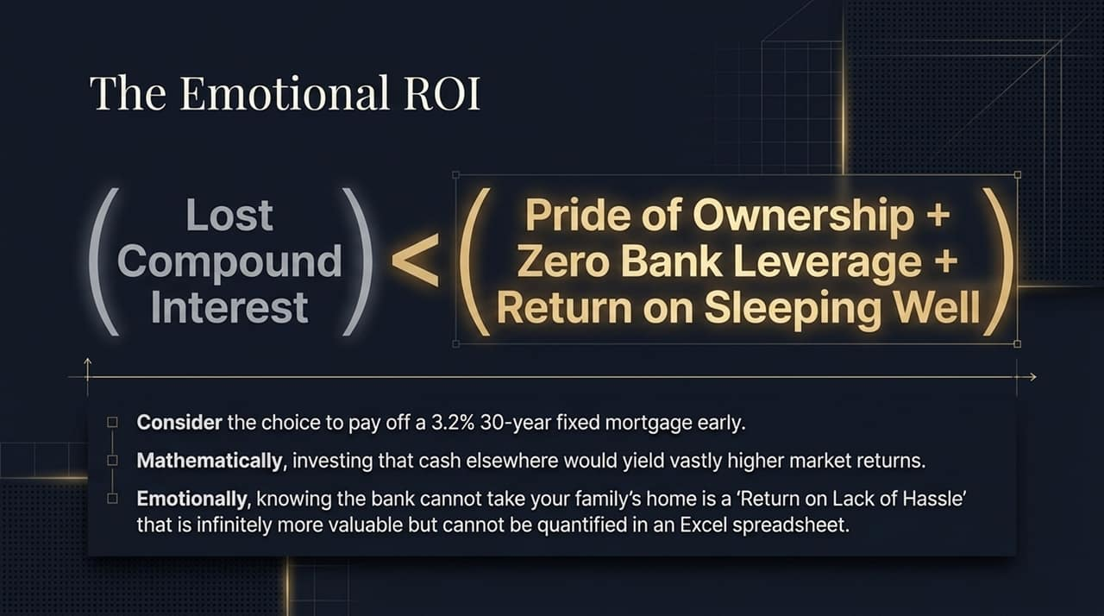
Notes:
Let's talk about something spreadsheets cannot compute: The Emotional ROI.
Consider a classic debate in personal finance: Should you pay off a 3.2%, 30-year fixed-rate home mortgage early? Mathematically, any financial advisor will tell you that paying off a 3.2% mortgage early is a terrible quantitative decision. If you take that extra cash and invest it in the S&P 500, you’ll likely yield vastly higher historical returns over 30 years.
But what does the spreadsheet ignore? It ignores the 'Return on Lack of Hassle' and the 'Return on Sleeping Well.'
When Housel paid off his low-rate mortgage, he acknowledged it was mathematically sub-optimal, but emotionally it was the best money decision he ever made. Knowing that no bank can ever evict your family, and that your baseline living costs are permanently lowered, offers an unquantifiable psychological safety net. Finance isn't about optimizing every single decimal point on a spreadsheet; it’s about making money choices that maximize your peace of mind.

Slide 7
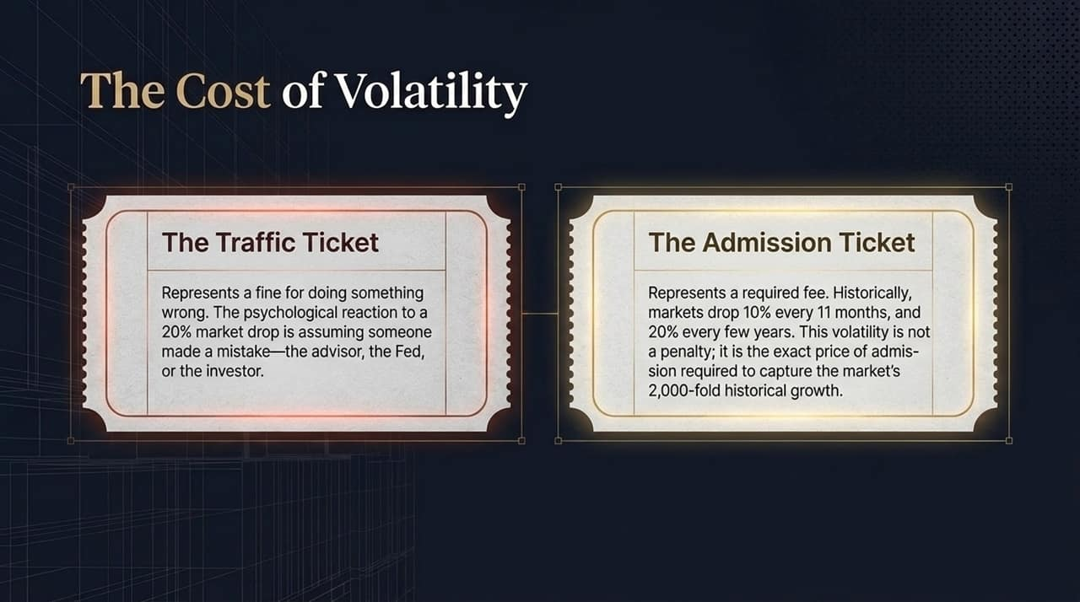
Notes:
How do you react when the stock market drops 20%? Slide 7 addresses the mental re-framing necessary to survive long-term investing.
Most people view market downturns as a Traffic Ticket. A traffic ticket is a fine for doing something wrong. So when the market drops 20%, investors assume someone screwed up—their financial advisor, the Fed, or their own strategy. Out of panic and shame, they sell out to make the pain stop.
But successful long-term investors view market volatility as an Admission Ticket.
Think of it like going to Disneyland. You don't stand at the front gate demanding a free ride; you pay the price of the ticket because the experience inside is worth it. Historically, the stock market drops 10% every 11 months and 20% every few years. That short-term terror is not a penalty; it is the precise cost of admission required to capture the market's long-term, 2,000-fold compounding returns. If you want gains without volatility, you're trying to sneak into the park without a ticket.

Slide 8
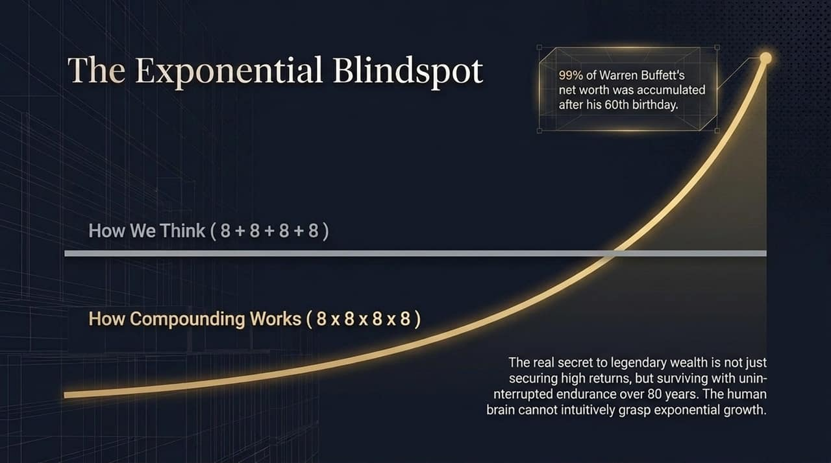
Notes:
Slide 8 highlights our human brain's natural limitation: The Exponential Blindspot.
If I ask you to compute $8+8+8+8$in your head, you can do it instantly. That is linear thinking. But if I ask you to calculate $8×8×8×8×8$, your brain freezes. We are simply not hardwired to intuitively process exponential math.
This is why almost everyone misinterprets Warren Buffett's wealth. Over 99% of Warren Buffett’s fortune was generated after his 60th birthday.
Was he a good stock picker? Absolutely. But his true secret weapon was endurance. He has been investing consistently for over 80 years. If he had retired at age 60 like an average person, the world would likely have never heard of him. Legendary wealth is rarely about generating astronomically high returns in a short window; it’s about securing good returns and surviving uninterrupted over extraordinary periods of time.

Slide 9
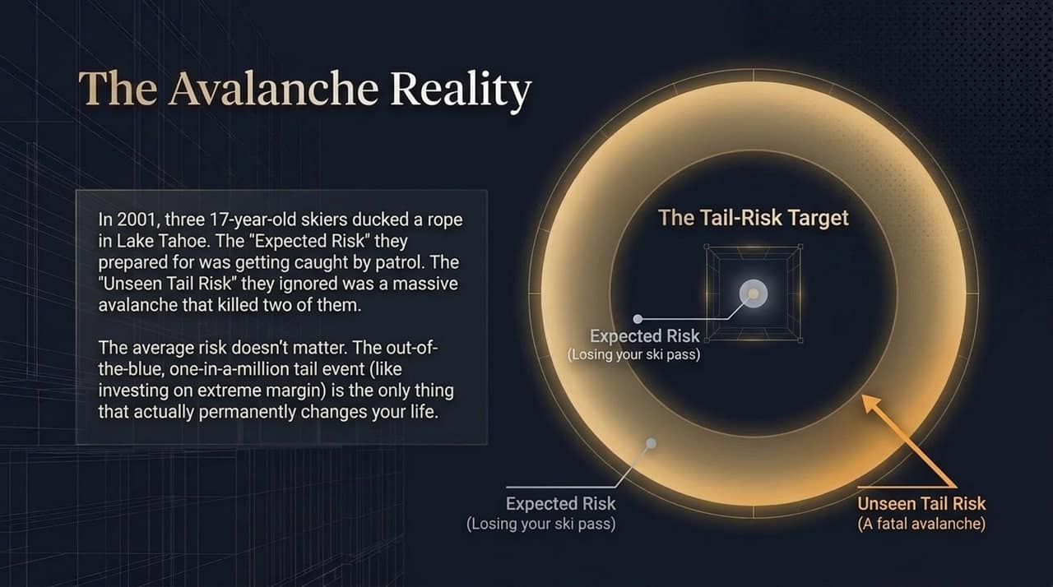
Notes:
To illustrate the reality of risk, let us look at a deeply personal story shared on Slide 9: The Tahoe Avalanche.
Back in 2001, when Housel was 17 years old, he was an elite competitive skier in Lake Tahoe. He and his two best friends regularly skied 'out of bounds' by ducking resort ropes. They knew there was risk involved, but in their teenage minds, the 'Expected Risk' they prepared for was getting caught by ski patrol and losing their lift passes.
One afternoon, after triggering a minor snow slide, Morgan decided not to do a second run. His two friends went back up. Twenty minutes later, a catastrophic avalanche hit the back side of the mountain. Both of his friends were swept away and buried under six feet of snow, tragically losing their lives.
The core lesson here is profound: The average risk in your life rarely matters. It is the out-of-the-blue, one-in-a-million 'Tail Risk' that permanently alters your world. In finance, losing 5% on an average trade won't ruin you. But taking on extreme margin debt or over-leveraging into a single asset creates a tail risk that can wipe you out completely and erase decades of progress.

Slide 10
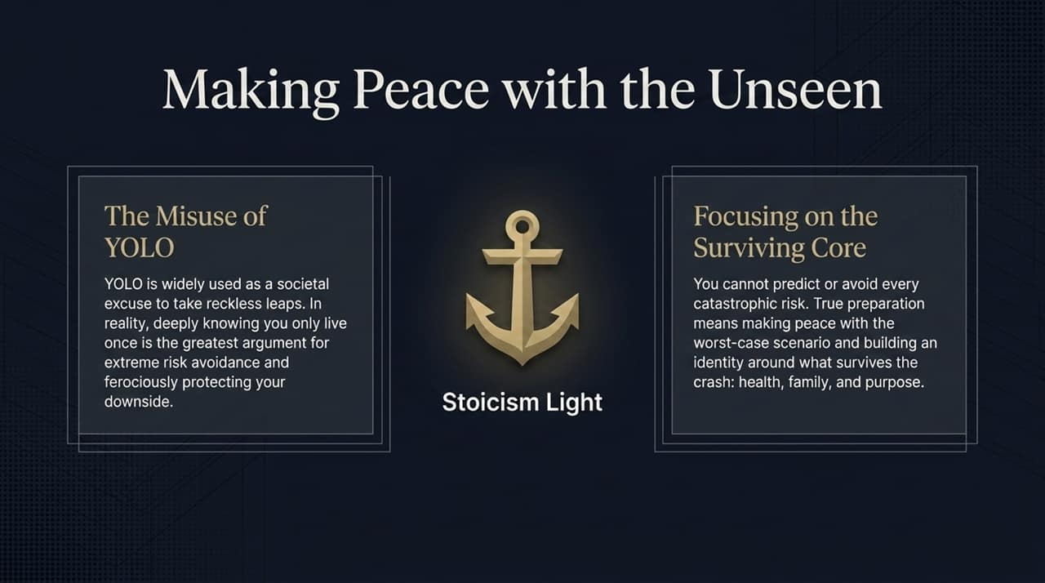
Notes:
How do we protect ourselves against tail risks we cannot foresee? Slide 10 provides a framework.
First, we need to correct society's misuse of the phrase YOLO ('You Only Live Once'). People usually blurt out 'YOLO' as an excuse to take foolish, short-term gambles. But in reality, knowing you only live once is the single greatest argument for extreme risk avoidance and downside protection. Because you only live once, getting wiped out permanently ends your game.
Second, adopt what Housel calls 'Stoicism Light.' Ancient Stoics used to mentally simulate horrific catastrophes daily to build resilience. You don't need to go to those extreme lengths, but you must make peace with worst-case scenarios.
You cannot predict every market crash or black swan event. True resilience comes from knowing what survives the storm: your core health, your family bonds, and your foundational purpose. Build a financial buffer so robust that even if the market experiences a generational shock, your core life remains intact.

Slide 11
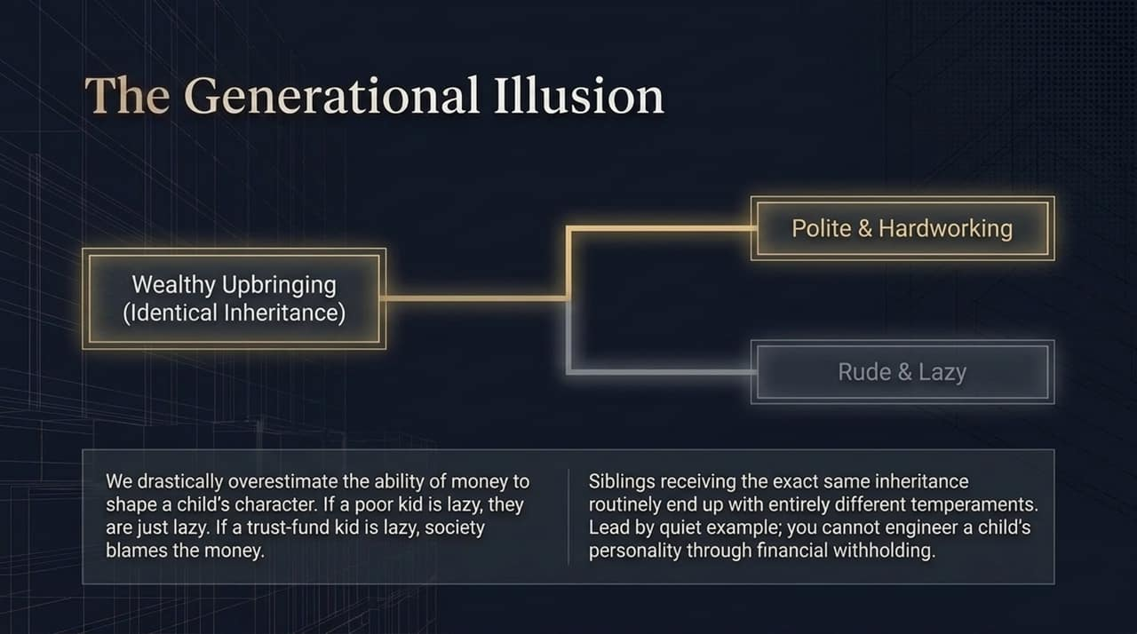
Notes:
For parents, Slide 11 tackles a very common anxiety: Will leaving money to my children spoil them?
We tend to drastically overestimate the power of money to engineer a child's character. Consider this breakdown:
If a child from a low-income background grows up rude and lazy, society simply calls them rude and lazy.
If a trust-fund child grows up rude and lazy, society points at the trust fund and says, 'The money ruined them!'
This is often a false cause-and-effect relationship. Look at families where multiple siblings receive the exact same inheritance under the same roof. One sibling often turns out humble, hardworking, and generous, while the other becomes entitled and irresponsible.
Money doesn't fundamentally change who a person is; it merely amplifies their underlying temperament. You cannot engineer your children’s internal values simply by withholding financial support. The best way to shape children is not through lecturing or financial engineering, but by quietly leading by example in how you handle money yourself.

Slide 12
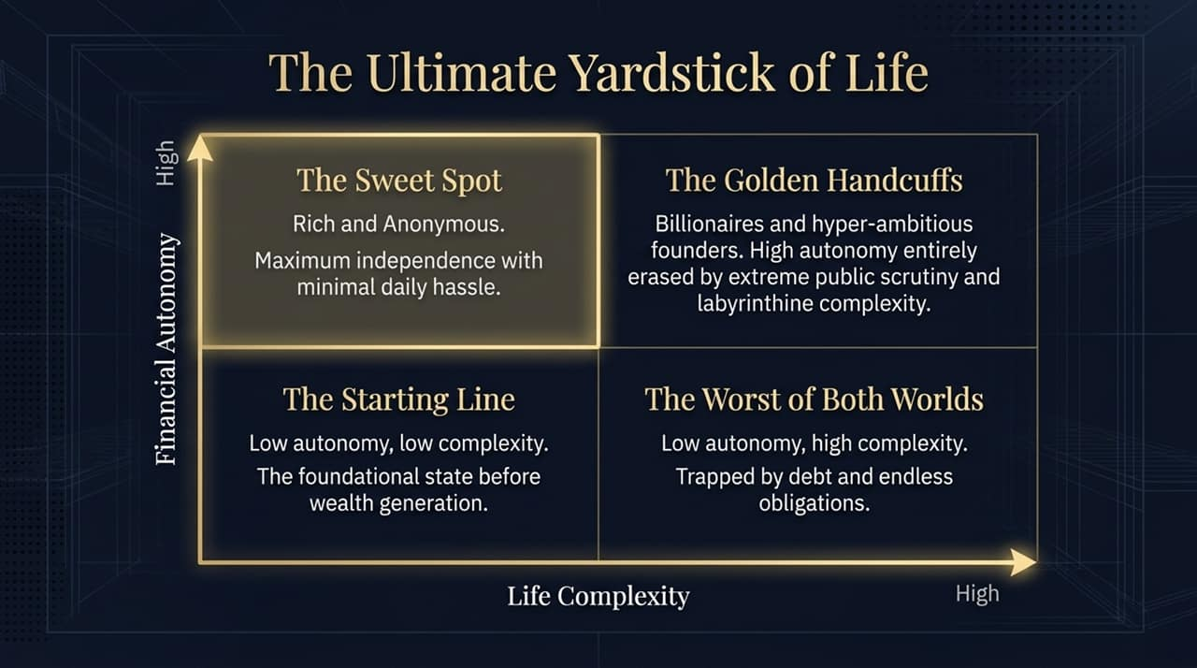
Notes:
Slide 12 maps out what might be the most practical evaluation tool in the deck: The Matrix of Autonomy and Complexity.
Let's look at where people land across these four quadrants:
Bottom-Left (Low Autonomy, Low Complexity): 'The Starting Line.' This is where most people begin before accumulating significant wealth.
Bottom-Right (Low Autonomy, High Complexity): 'The Worst of Both Worlds.' Trapped under consumer debt, mortgages, and complex lifestyle maintenance without any real financial independence.
Top-Right (High Autonomy, High Complexity): 'The Golden Handcuffs.' High net-worth founders or public figures who have hundreds of millions, but their actual daily autonomy is erased by legal battles, public scrutiny, and massive obligations.
Top-Left (High Autonomy, Low Complexity): 'The Sweet Spot — Rich & Anonymous.'
Naval Ravikant famously said the ideal state in life is to be Rich and Anonymous. You have total financial resources to do whatever you want, but you can walk down any street without public scrutiny or administrative drag. Maximum independence with minimal complexity—that is the ultimate benchmark.

Slide 13
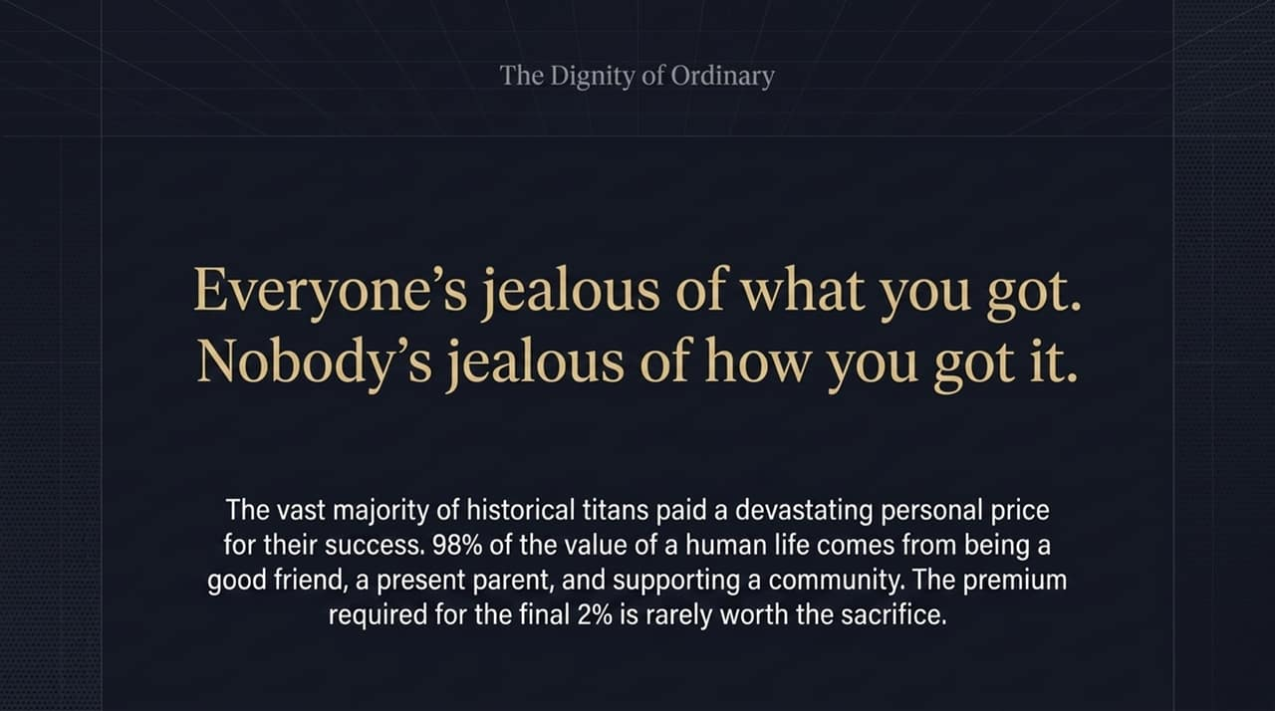
Notes:
Slide 13 brings us to an important philosophical lesson: re-evaluating our role models.
As comedian Jimmy Carr noted: 'Everyone is jealous of what you've got, but nobody is jealous of how you got it.'
We often look at titan entrepreneurs, billionaires, or famous icons and envy their final output. But when you examine the lives of these individuals, the vast majority paid a crushing personal tax to achieve that final 2% of elite success. They sacrificed their health, destroyed marriages, missed their children's youth, or lived under immense anxiety.
There is tremendous dignity in living an ordinary, peaceful life. Over 98% of true life satisfaction comes from simple, unglamorous things: being a present parent, a reliable friend, taking long walks, and enjoying peaceful mornings. Don't admire someone’s financial standing unless you are genuinely willing to pay the exact personal price they paid to get it.

Slide 14
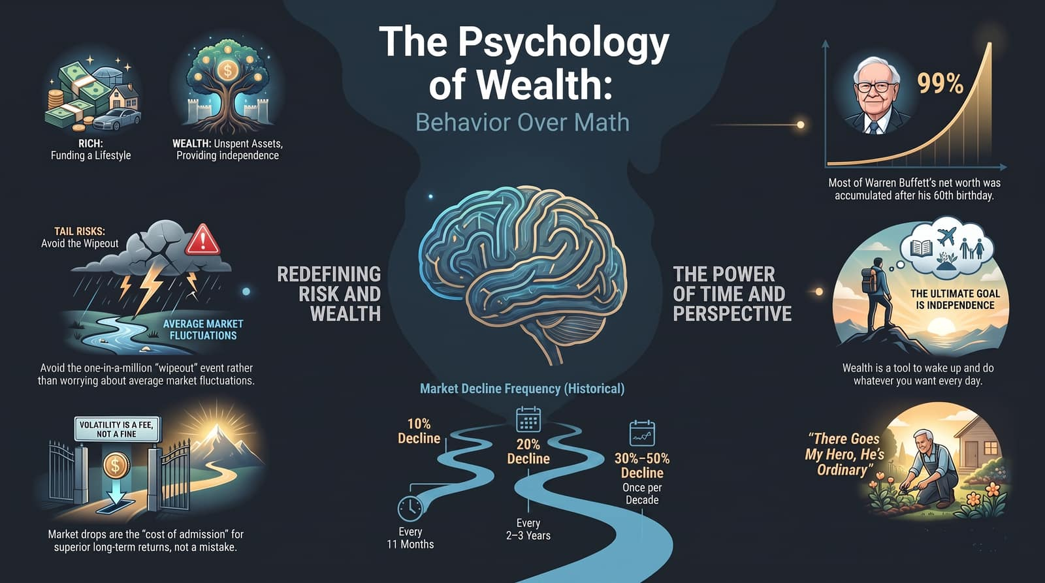
Notes:
As we begin wrapping up our key themes, Slide 14 synthesizes the core principles of redefining risk and wealth:
1. Rich vs. Wealthy: Focus on unspent assets that buy independence rather than high-cost lifestyle displays.
2. Avoid Tail-Risk Wipeouts: Protect yourself against single points of catastrophic failure rather than stressing over normal, short-term market fluctuations.
3. Volatility is a Fee, Not a Fine: Accept market drawdowns—whether a 10% dip every 11 months or a 20% drop every few years—as the natural price for superior long-term returns.
4. The Power of Perspective: Let compounding do the heavy lifting over decades, understanding that patience and endurance are far more powerful than timing.

